Slide 1

ENTERPRISE SOLUTION
April 2026
HR Management
System
Comprehensive Digital HR Solution — End-to-End Workforce Management
Md. Rakibul Islam Ratul
Secure
Mobile-Ready
Cloud-Based
Sr. Manager, Telecom, Metal

Slide 2
Agenda
Comprehensive system overview and module breakdown
01
System Overview & Tech Stack
08
Approval Workflow Engine
Architecture & technologies
Multi-level approval chains
02
Employee Management Module
09
Compliance Engine
Profiles, lifecycle & transfers
Labor law automation
03
Attendance Management Module
10
Admin Panel & Configuration
GPS tracking & smart detection
System administration tools
04
Leave Management Module
11
Analytics & Reporting
Leave types & approval workflow
Dashboards & insights
05
Payroll & Salary Module
12
Mobile Application
Automated salary processing
Android app capabilities
06
Shift & Roster Management
13
Security & Architecture
Duty scheduling & overrides
Data protection & infrastructure
07
Policy Management Module
14
Benefits & ROI
Leave & salary policies
Business value & outcomes

Slide 3
System Overview
What is HRMS?
A full-stack Human Resource Management System designed to digitize and automate all HR operations — from employee onboarding to payroll processing. It replaces manual spreadsheets and paper-based workflows with a centralized, web-based platform accessible from both desktop and mobile.
Technology Stack
Layer | Technology
Backend | Node.js, Express 5
Database | MongoDB (Cloud/Atlas)
Frontend | HTML5, CSS3, JavaScript (SPA-style)
Mobile | Capacitor (Android App)
File Handling | Excel Import/Export (xlsx), Image Upload (Multer)
API | RESTful API Architecture
50+ API Endpoints
11 Database Models
17 Frontend Modules
6 Admin Pages

Slide 4
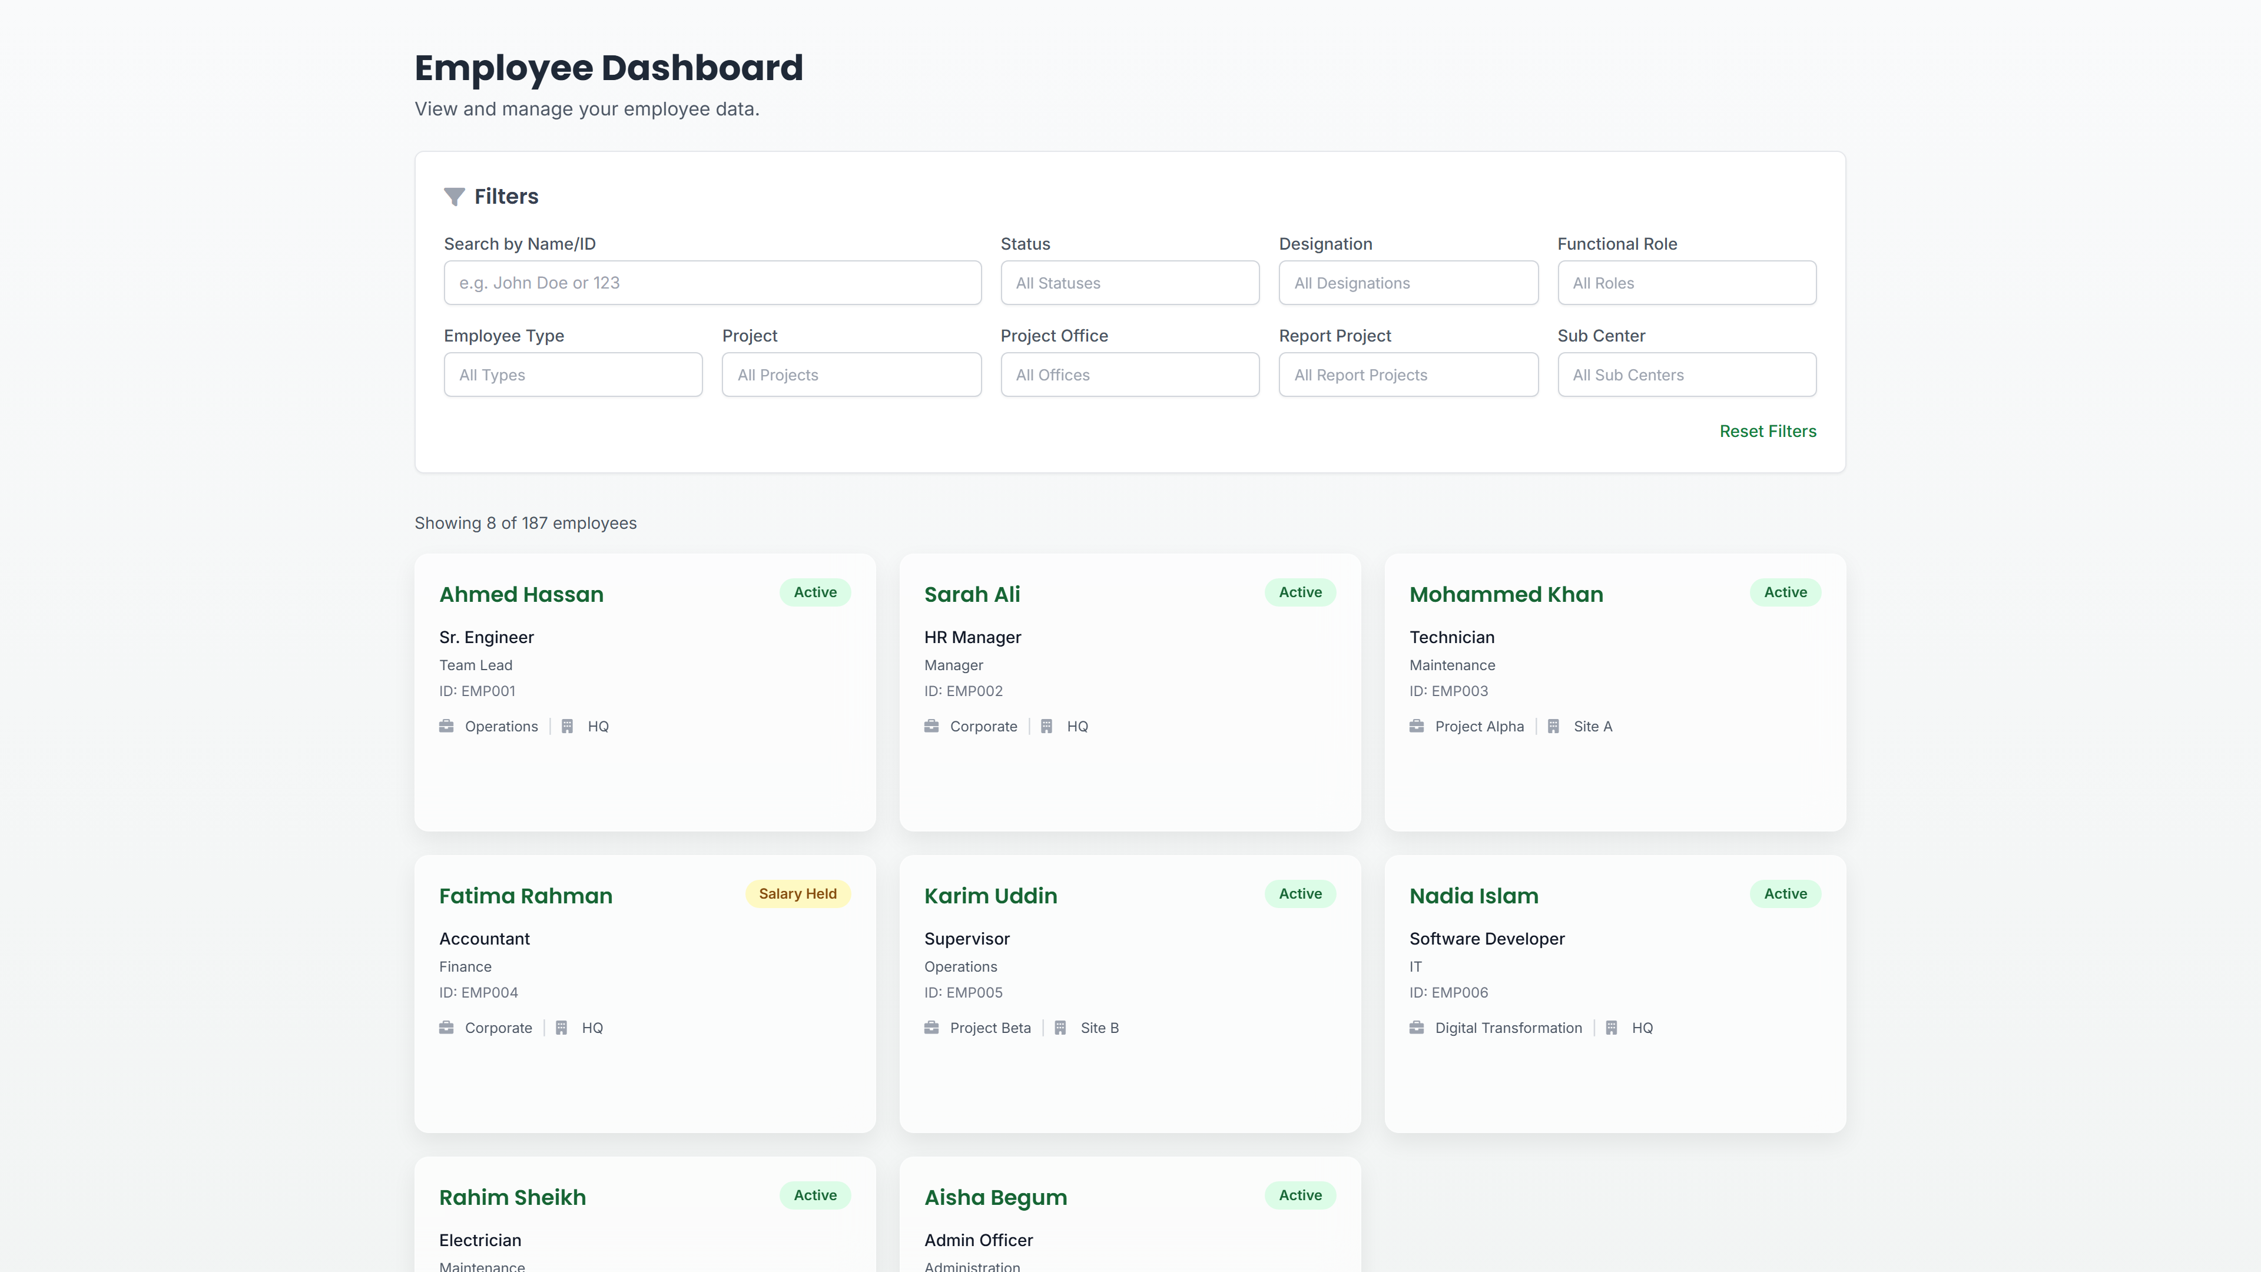
Employee Management Module
Complete employee lifecycle management
Core Features
Employee Data Captured
Full Employee Profiles: Employee ID, name, designation, department, project, sub-center, personal details
ACTUAL PROJECT SCREENSHOT
Personal Info
hrms.metal.com/dashboard
Employee Types: Regular, Casual, Contractual, Temporary
Name, Father's Name, DOB, Gender, Address, NID, Phone, Email
Status Lifecycle: Active → Salary Held → Resigned/Terminated → File Closed
Transfer Management: Record inter-project/sub-center transfers with complete history
Employment Info
Employee ID, Type, Designation, Joining Date, Project, Office, Sub-Center
Separation Workflow: Resignation and termination recording with date and remarks
Salary Structure
Bulk Upload: Import hundreds of employees via Excel spreadsheet
Gross Salary, Basic, Food Allowance, Station Allowance, Hardship Allowance, Conveyance, Medical, Other Earnings
Advanced Search: Filter by name, status, designation, type, project, sub-center
Deductions
Gratuity, CPF, Festival bonus, Loan Deduction, TDS, Other Deductions
Leave Balances
Sick Leave (14 days), Casual Leave (10 days), Earned Leave
Employee Dashboard — Live Screenshot
100%
4 Types
5 Stages
Excel
Digital Records
Employee Categories
Status Lifecycle
Bulk Import

Slide 5
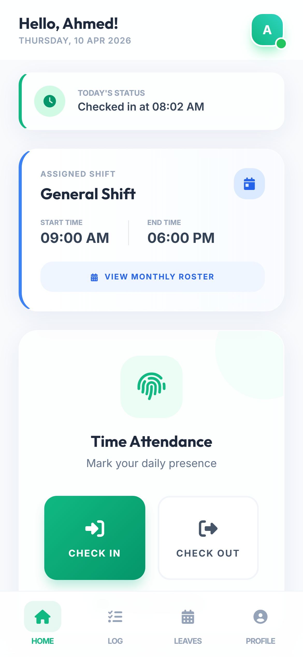
Attendance Management Module
GPS-based attendance with smart detection
GPS Check-In/Out
Geo-Fencing
Selfie Capture
Employees check in/out with real-time GPS location capture for accurate tracking
Configurable radius from office coordinates — flags if employee is out of range
Mandatory selfie photo at check-in and check-out for identity verification
Smart Detection Engine
Late Arrival
Early Departure
Over-Duty
Out-of-Range
Detection based on shift time + grace period
Flags employees leaving before shift end
>9 hours requires justification
Beyond geo-fence radius detection
Justification System
Reporting & Tracking
Employees must provide reasons for violations, which go through multi-level approval workflow
Monthly attendance reports exportable to Excel
Real-time tracking of today's attendance status
Mobile Attendance UI

Slide 6
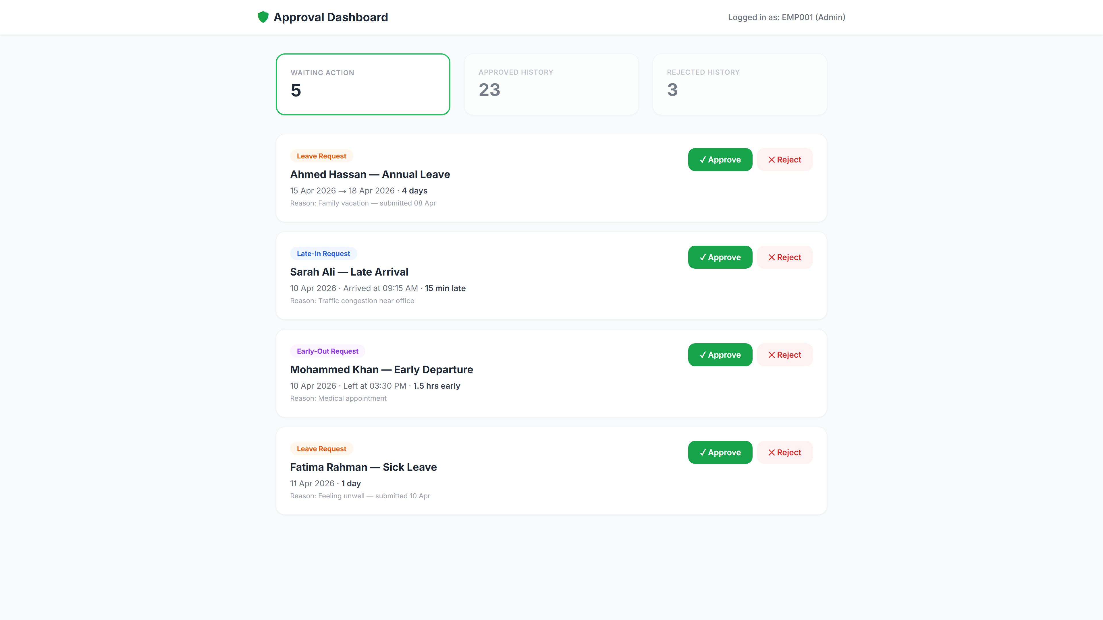
Leave Management Module
Comprehensive leave tracking and approval workflow
Leave Types & Entitlements
Leave Type | Days/Year | Details
Sick Leave | 14 days | Medical leave with balance tracking
Casual Leave | 10 days | Personal/casual leave
Earned Leave | Accrued | Based on service duration
LWP (Leave Without Pay) | Unlimited | Salary deducted for absent days
hrms.metal.com/approvals?id=EMP001
Key Features
Approver Dashboard
Online leave application with date range and reason
View all pending leave requests
Automatic leave balance checking and deduction
Approve or reject with comments
Multi-level approval workflow (sequential approvers)
Complete action history log
Complete leave history per employee
Leave & Approval Dashboard — Live Screenshot
Email notifications for new requests
Pending leave status checker
Mobile-friendly approval interface

Slide 7
Payroll & Salary Module
Automated salary processing and payslip generation
Salary Sheet Generation
Monthly salary sheet generation with all earnings and deductions + automatic net salary calculation
Earnings Components
Deductions Components
Basic Salary
Slab-based
Gratuity
Percentage
Food Allowance
Fixed
CPF (Provident Fund)
Percentage
Station Allowance
Fixed
Festival Advance Recovery
Fixed
Hardship Allowance
Conditional
Loan Deduction
Fixed
Conveyance
Fixed
TDS (Tax)
Calculated
Medical Allowance
Fixed
Other Deductions
Variable
Festival & Incentive Bonus
Percentage
Individual Payslips
Payroll Archival
Historical Browser
Slab-Based Policy
Per employee generation
Permanent storage
View past months
Joining date logic

Slide 8
Shift & Roster Management
Flexible duty scheduling and shift assignment
Shift Management
Duty Roster System
General Shift
09:00–18:00
1
Download Template
Standard office hours with configurable grace period
Pre-filled Excel roster with employee names and IDs
Morning Shift
Custom
2
Fill Shift Codes
Early morning duty assignment
G=General, M=Morning, E=Evening, N=Night, O=Off Day
Evening Shift
Custom
3
Upload Roster
Late evening duty assignment
System auto-assigns shifts for the entire month
Night Shift
Custom
Per-Employee Overrides
Overnight duty assignment
Individual shift adjustments without affecting the entire roster
Shift Resolution Priority Hierarchy
1
2
3
4
Duty Roster
Global Schedule
Assigned Shift
Default
Highest Priority
Org-wide overrides
Employee default
09:00–18:00

Slide 9
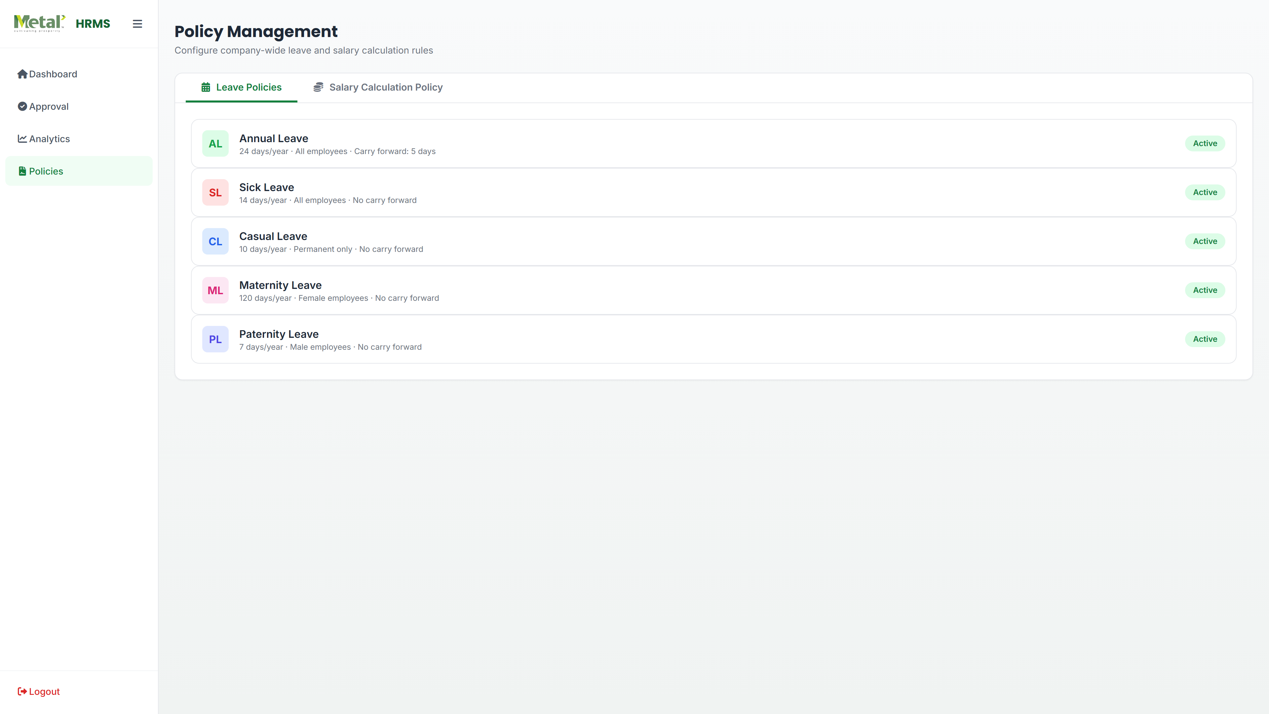
Policy Management Module
Configurable leave and salary policies
Leave Policies
Salary Policies
hrms.metal.com/policies
Configurable Settings
Slab-Based Configuration
Days allowed per leave type
Basic salary percentage by gross range
Employee type applicability
Joining date cutoff logic
Gender restrictions (M/F/All)
Festival bonus percentage
Carry-forward rules
Incentive bonus configuration
Policy Example
Slab Example
Sick Leave:
14 days/year (All employees)
Gross ≤ 30,000:
Basic = 60% of Gross
Casual Leave:
10 days/year (Regular only)
Gross 30,001–50,000:
Basic = 55% of Gross
Maternity Leave:
180 days (Female only)
Gross > 50,000:
Basic = 50% of Gross
Policy Flexibility
100%
Real-time
Audit
Different policies for different employee types and joining dates
Policy Configuration — Live Screenshot
Configurable
Updates
Trail

Slide 10
Approval Workflow Engine
Multi-level hierarchical approval system
Three-Tier Hierarchy Resolution
1
Employee Level
2
Sub-Center Level
3
Reporting Manager
hrms.metal.com/admin_approvals
Highest Priority — Individual hierarchy overrides set on the employee record
Default hierarchies defined for the employee's sub-center
Auto-built chain from reporting manager field (2-level)
Overrides all other levels
Location-based defaults
Automatic chain building
Separate Approval Hierarchies
Workflow Process
Leave Approval
1
Request Submitted by Employee
All leave type requests
2
First Approver Reviews & Acts
Check-In Approval
Late arrival & violations
3
Sequential Approval Chain
Multi-level Approval Workflow — Live Screenshot
Check-Out Approval
Early departure & over-duty
Final Approval/Rejection

Slide 11
Compliance Engine
Automated labor law compliance monitoring
Automated Labor Law Compliance Rules
Rule | Threshold | System Action
Consecutive Working Days | 7 days | Warning + Justification Required
Consecutive Working Days | 10 days | Check-in BLOCKED
Weekly Total Hours | 48 hours | Warning Issued
Weekly Overtime | 12 hours OT | Check-in BLOCKED
Weekly Total Hours | 60 hours | Check-in BLOCKED (Hard Cap)
Annual Avg Weekly Hours | 56 hours/week | Flagged for Review
Over-Duty (Single Day) | >9 hours | Check-out Justification Required
Flexibility Options
Compliance Monitoring
Per-employee relaxation override for special cases
Automatic rule checking on every check-in/out
Per-sub-center compliance rules via Sub-Center Settings
Instant warnings and blocks
Real-time compliance status monitoring per employee
Complete audit trail of all compliance events

Slide 12
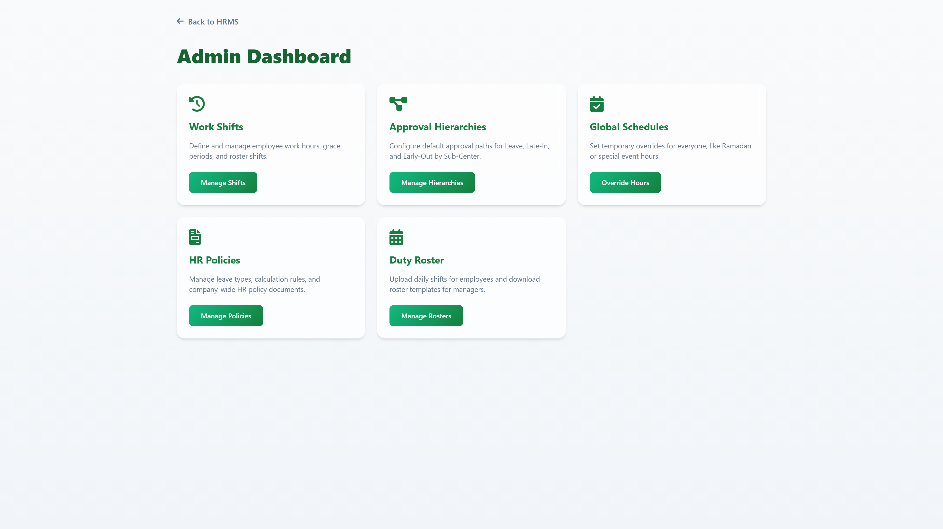
Admin Panel & Configuration
Centralized system administration tools
Shift Configuration
Approval Hierarchy
Global Schedule
hrms.metal.com/admin
Create, update, and delete shift definitions with start time, end time, and grace period settings
Configure multi-level approval chains per sub-center for leave, check-in, and check-out
Set organization-wide schedule overrides for holidays, Ramadan hours, and special events
Duty Roster Mgmt
Sub-Center Settings
User Management
Download pre-filled templates, upload completed rosters, and manage monthly shift assignments
Configure hierarchies, compliance rules, and location-specific settings per sub-center
Create and manage Admin, Manager, and Employee user accounts with role-based permissions
Admin Capabilities Summary
Admin Control Panel — Live Screenshot
6
50+
3
100%
Configuration Modules
Admin Functions
User Role Types
Web-Based Access

Slide 13
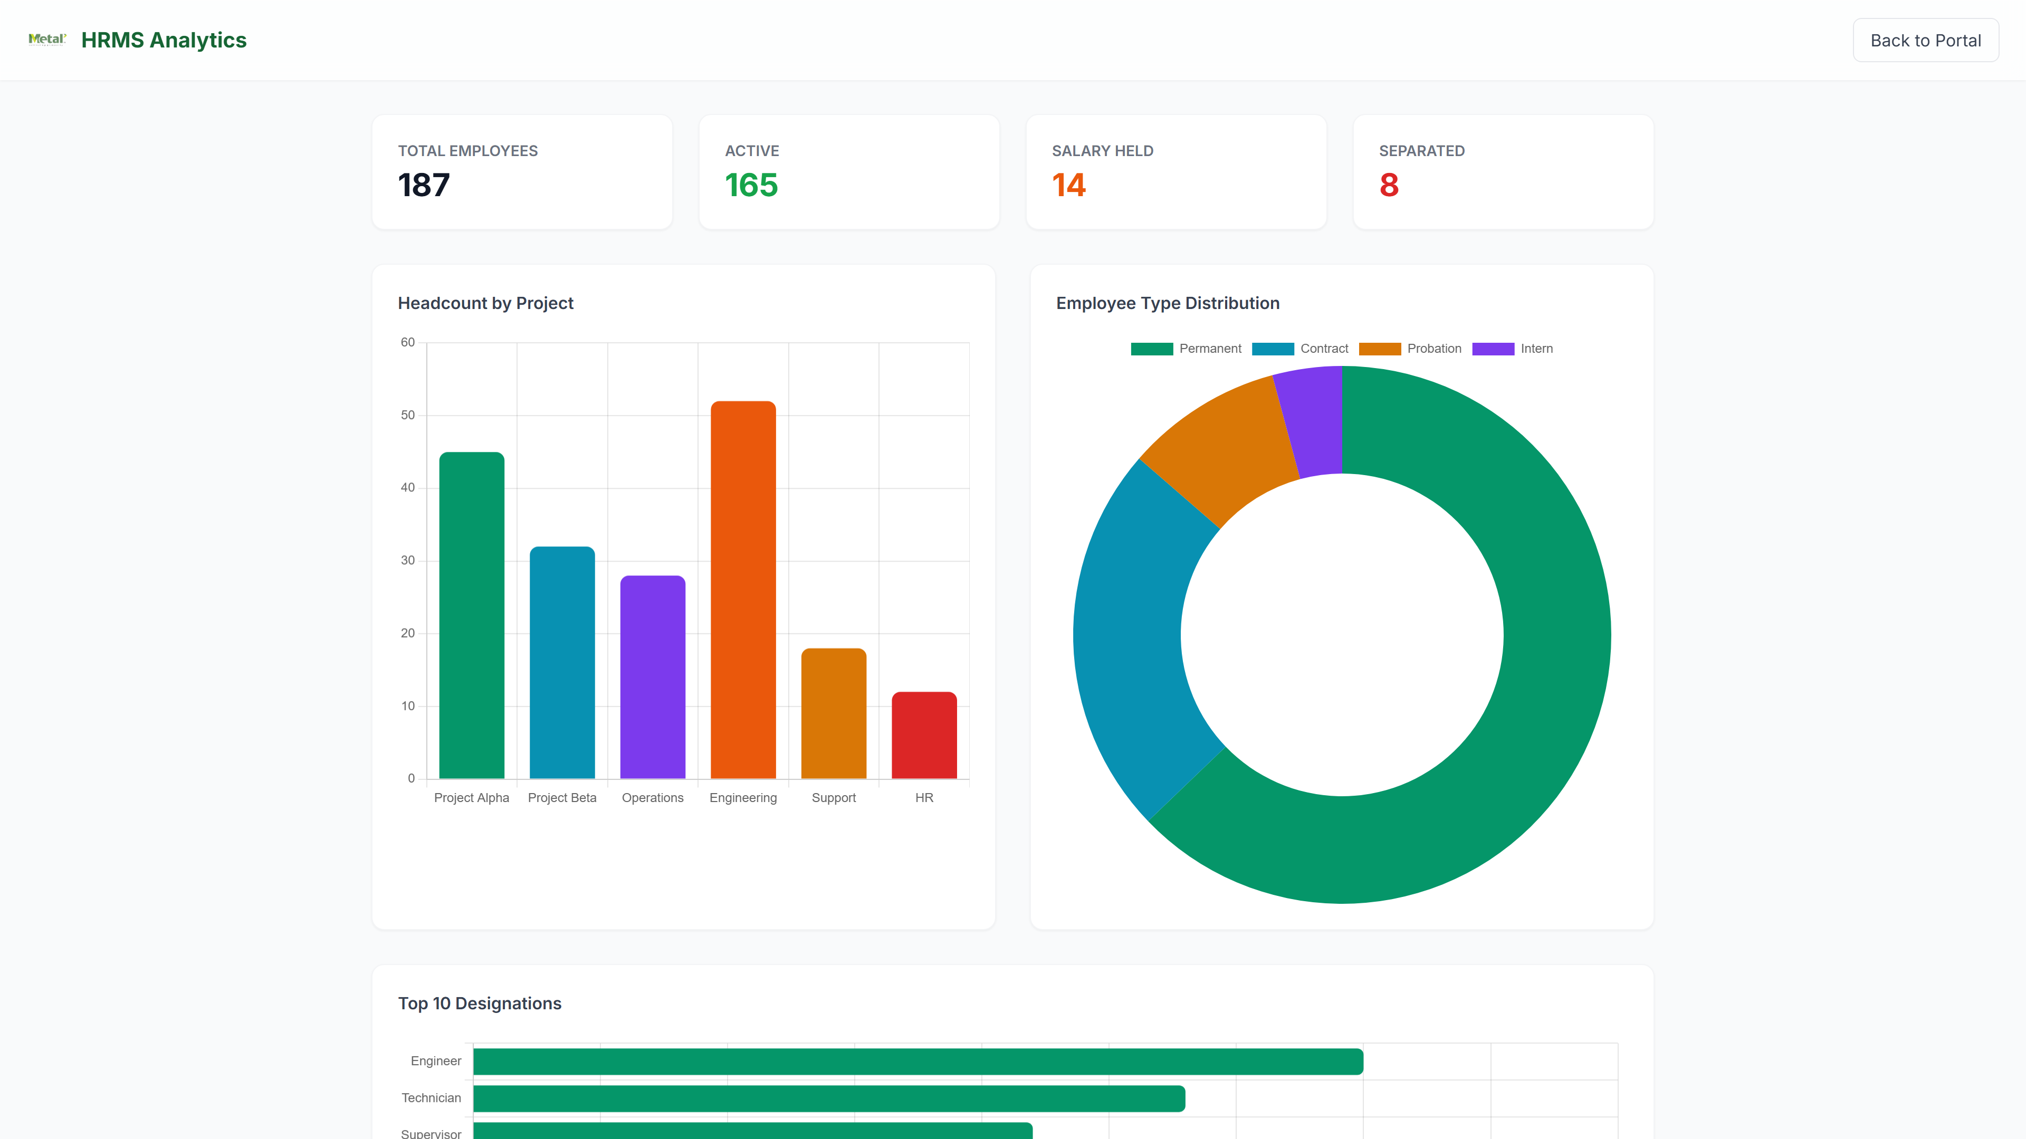
Analytics & Reporting
Comprehensive insights and data visualization
Dashboard Statistics
Exportable Reports
ACTUAL PROJECT SCREENSHOT
Total Employees
Attendance Reports
hrms.metal.com/analytics
Organization-wide headcount
Monthly summary in Excel format
Active vs Inactive
Salary Hold Log
Real-time status distribution
Track employees with held salaries
Department-wise Distribution
Separation Log
Breakdown by department/project
View all resignations and terminations
Transfer Log
Complete transfer history
File Closing Log
HR Analytics Page
Track all closed employee files with separation dates, reasons, and closure status for audit compliance
Analytics Dashboard with Charts — Live Screenshot
Visual analytics and interactive charts for management insights including trends, patterns, and KPIs

Slide 14
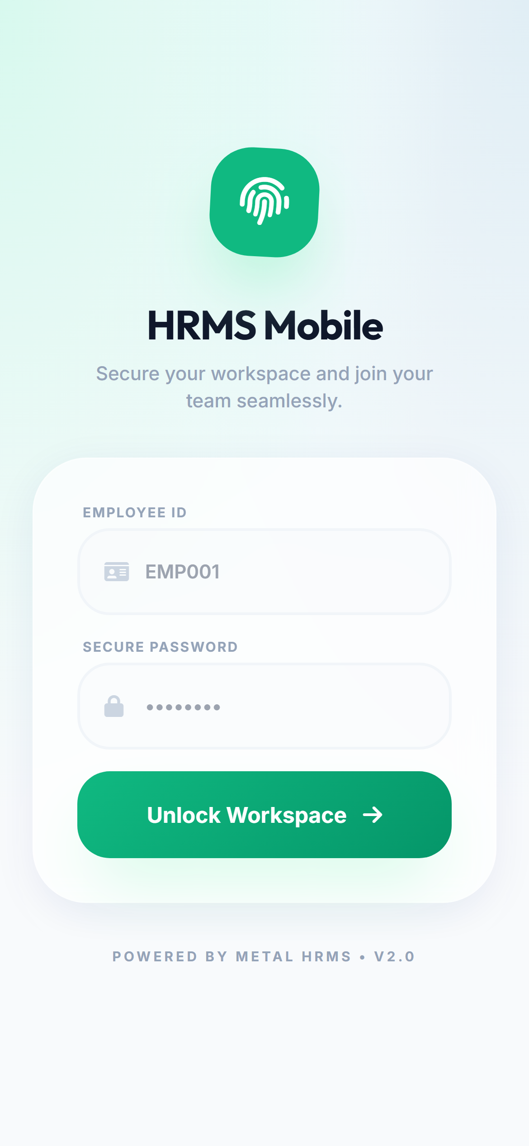
Mobile Application
Android app for on-the-go HR operations
App Details
Mobile Features
LIVE APP SCREENSHOTS
Platform
Mobile-Optimized Login
Android (via Capacitor framework)
Touch-friendly authentication
App ID
Mobile Dashboard
com.metal.hrms
Quick actions and status overview
GPS Attendance with Selfie
Deployment
Check-in/out with location & photo
Built and deployed via Android Studio
Leave Application
Apply for leave on-the-go
Attendance History
View past attendance records
Leave Balances
Real-time balance checking
Push Notifications
Instant alerts for approvals
Mobile-First Design
100%
Offline
Secure
Responsive interface optimized for smartphones and tablets
Feature Parity
Capability
Data Transfer
Mobile Login Screen
Mobile Dashboard

Slide 15
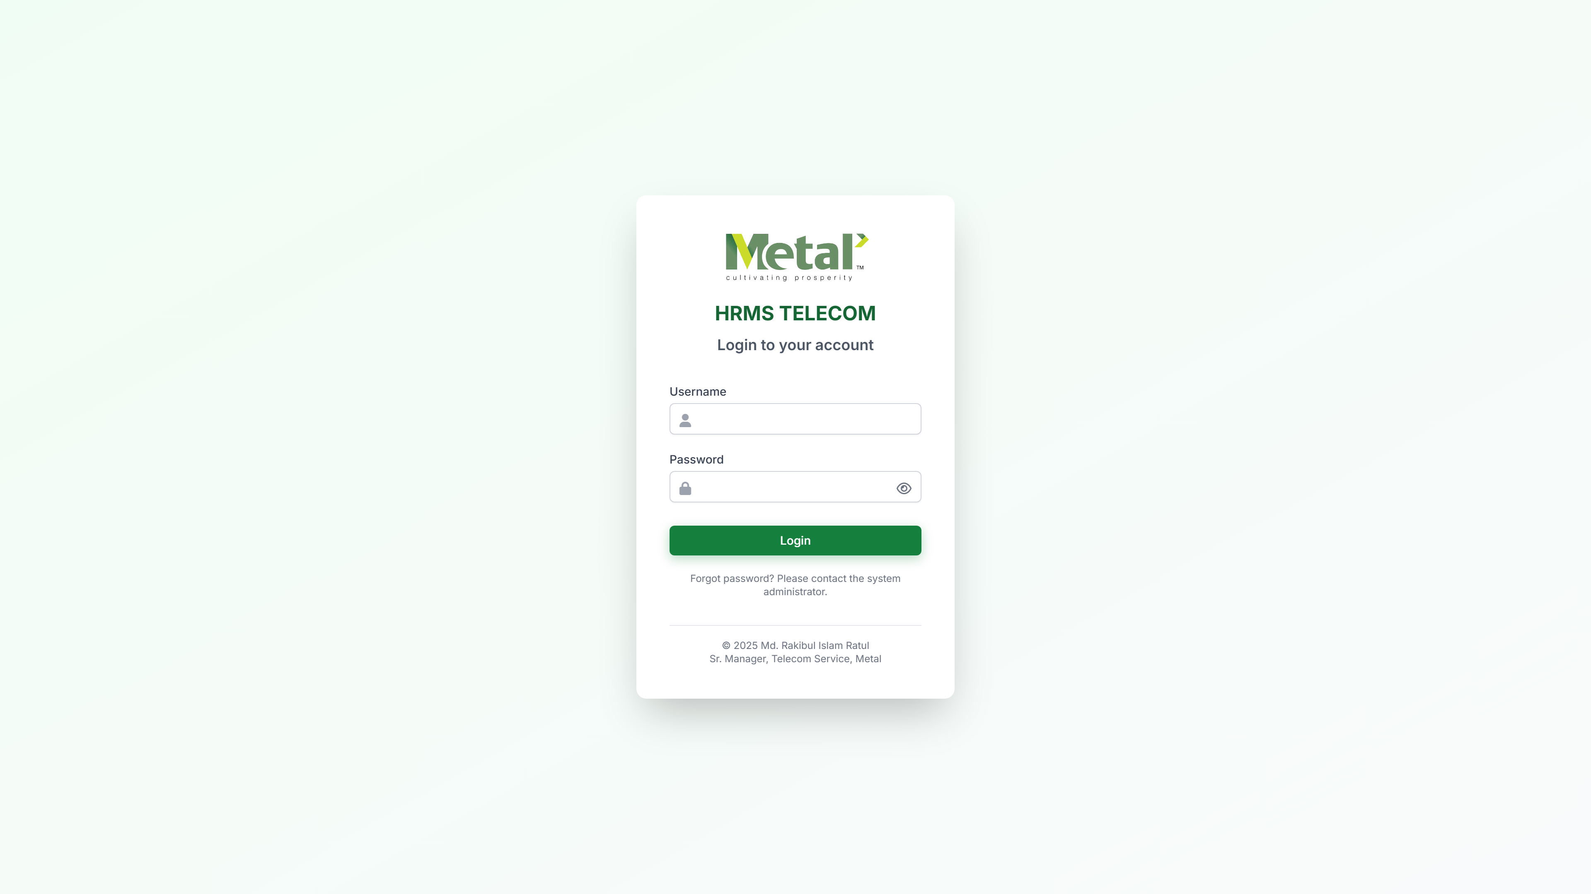
Security & Architecture
Enterprise-grade security and robust architecture
Authentication & Access
Data & File Security
Username/Password Auth
MongoDB Atlas
Hashed passwords with secure storage
Cloud database with encrypted connections
Role-Based Access Control
Secure File Storage
hrms.metal.com/login
Admin, Manager, Employee permissions
Selfies, rosters stored securely on server
API Route Protection
RESTful API Architecture
Role-based middleware validation
Clear separation of concerns
Client-Server Architecture
Client Layer
HTML5/CSS3/JS Frontend + Capacitor Mobile App
Data Layer
Secure Authentication Portal
MongoDB Atlas (Cloud)
11 Models
50+ Endpoints
Server Layer
Encrypted
Scalable
Node.js + Express 5 + RESTful API

Slide 16
System Benefits & ROI
Business value and transformation outcomes
Eliminates Paper
Time Savings
Accuracy
100% digital HR operations — no more manual forms, spreadsheets, or paper-based workflows
Automated salary calculation, attendance tracking, and leave management saves hours daily
Reduces human error in payroll processing, attendance tracking, and compliance monitoring
Compliance
Transparency
Accessibility
Automated labor law compliance monitoring with real-time alerts and blocking
Multi-level approval workflows with full audit trails for every action
Available on desktop and mobile — anytime, anywhere access
Scalability
Cost Reduction
Data-Driven Decisions
MongoDB-based architecture handles growing workforce without performance issues
Reduces HR administrative overhead significantly through automation
Analytics and reporting provide management insights for strategic planning

Slide 17

Thank You
Questions & Discussion
Md. Rakibul Islam Ratul
Sr. Manager, Telecom
Contact for Demo
Technical Support
Schedule Meeting
Enterprise Security
Cloud-Based
Mobile Ready

